Slide 1
International Hydrographic Organization
11th Meeting of the Inter Regional Coordination Committee (IRCC-11)
Genoa, Italy 3 – 5 June 2019
International Cable Protection Committee
IRCC11-09B ICPC Update & Activity Report
Graham Evans ICPC Vice Chairman
Managing Director EGS Survey Group
gevans@egssurvey.com

Slide 2
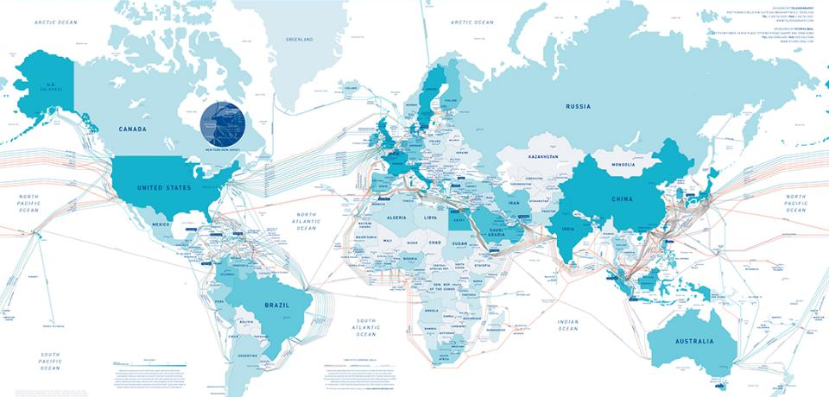
Global extent of submarine cables
The world is connected by more than
400
>1.2 million
kilometers of cable installed
enough cable to
circle the Earth
>25 times
submarine CABLE SYSTEMS
Notes:
The world is currently connected by more than 400 undersea cable systems, with more than 1,200,000 kilometers of cable—an aggregate amount sufficient cable to circle the Earth over 25 times. – flash up this slide for a few seconds

Slide 3
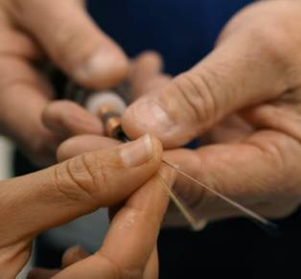
Global importance of submarine cables
>99%
  Submarine cables are the BACKBONE of the Internet, garden hose-sized cables carrying vast amounts of traffic over glass fibers.
of international Internet, voice, and data traffic travels via submarine fiber optic cables.
AND A Growing Green Power Network
through international power cables
Submarine telecom cables ensure access to Facebook, Instagram photos, YouTube videos, Google search results, and Office365 documents and email, whether from a laptop computer, tablet or mobile phone.
Submarine telecom cables backhaul most of the world’s international mobile network traffic.
Submarine power cables are increasingly internationally transmitting GREEN POWER.
Notes:
Contrary to popular belief, 99 percent of international voice and data is transmitted through undersea fiber optic cable. The World Wide Web is connected across the oceans. Power cables are increasing in their significance in the transport of clean power internationally. – flash up this slide for a few seconds

Slide 4

Submarine cables are critical infrastructure
Governments designate submarine cables as critical infrastructure.
Governments use critical infrastructure designations to highlight asset criticality and identify and mitigate vulnerabilities and threats.
Critical infrastructure is frequently defined as:
Assets that are essential for the functioning of society and the economy, and
Damage or destruction of which would harm national and economic security, public health, and public safety.
Notes:
Submarine cables are critical infrastructure – flash up this slide for a few seconds

Slide 5
Submarine cables are critical infrastructure
Submarine cables carry >5.4 petabytes (10¹⁵) of data per minute, >4 million YouTube views; >400 minutes of video uploaded every minute; 4 million Facebook posts per minute
Each day the Society for Worldwide Interbank Financial Telecommunications (SWIFT) transmits ≈ 15 million messages to more than 8300 banking organizations, securities intuitions, and corporate customers in 208 countries
The United States Clearing House for Interbank Payment System (CHIPS) process over US$ 1 Trillion per day to more than 22 countries for all manner of commodity exchanges, investments, and securities
World Bank study indicated a 10% increase in broadband penetration results in a 1.38% increase in GDP growth in low and middle income countries
Notes:
Submarine cables are critical infrastructure – flash up this slide for a few seconds

Slide 6
About the ICPC
Founded in 1958, ICPC is the world’s preeminent global organization for:
Advancing freedoms to install and maintain submarine cables, and
Mitigating risks of damage to those cables.
ICPC has more than 180 private-sector and government members from more than 60 countries and:
Works with governments, other marine industries, international organizations, and NGOs to promote cable awareness, cable protection legislation, and effective international agreements;
Commissions peer-reviewed research on the environmental characteristics of cables; and
Promulgates recommendations for cable operators.
ICPC accorded NGO Special Consultative status by ECOSOC
Liaises with UN Bodies including UNEP, ISA, ITU and IMO and regional Cable Protection Committees (CPCs)
Actively participating at UN IGC sessions related to BBNJ
Notes:
The ICPC has been around for more than 60 years and works with ESCA and other regional organisations to promote submarine cable protection and the protection of cable freedoms enshrined in the United Nations Convention o the Law of the Sea – Flash up this slide only for as long as it takes to say the previous sentence

Slide 7
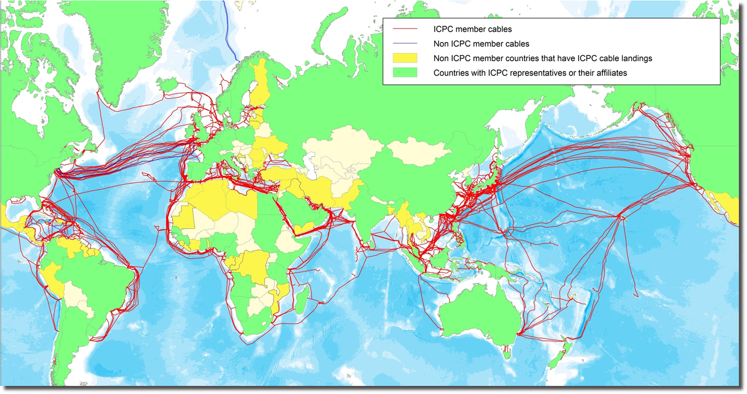
ICPC Membership Coverage
ICPC represents 98% of installed International Cable Kilometres

Slide 8
Cable Protection & Cable Awareness
Cable protection can be engineered through armouring and cable burial
However, cables do remain vulnerable to third party actions particularly from anchors, fishing activity and increasingly from deep sea mining and renewable energy activities
Cable awareness initiatives have been developed by regional Cable Protection Committees (CPCs) for example KIS-ORCA for UK/Europe
Otherwise cable awareness relies on published navigational charts
The accuracy charted cables is critical; occaisionaly discrepancies occur when comparing charted position with as-laid position; possibly resulting from the use of the 10 point rule employed in some cases
Cable awareness plays a critical role not only in the protection of the submarine cable infrastructure
Cable awareness also plays a key role in Safety at Sea as not only power cables but also telecom cables can carry very high voltages.

Slide 9
Worldwide Cable Faults by Depth

Slide 10
Total Faults <1,000m by Cause

Slide 11
Fault Analysis - Conclusions
83% of all faults occur in <1,000m water depth
71% of faults occur in <200m
All submarine cable systems transit this aggression zone
Although there is a need to focus on shallow water cable security, an increasing risk to telecommunication cables is being posed in water depths exceeding 2,000m beyond which cables are currently not routinely charted (IHO S4 B-443) by:
  Deep sea mining activity
  Frontier block oil and gas developments

Slide 12
ICPC & IHO
ICPC invited to participate at HSSC-7 in Busan November 2015
IHO/ICPC MoU signed April 2016
Key MoU objectives:
  Develop uniform cable charting standards for submarine cables adopted globally by HOs
  Understanding compatible digital input formats for as-laid cable data that address IHO charting requirements
  Reduction of lead times from as-laid cable data availability
  A global approach to the issuance of Notices to Mariners for new cables
  Develop standardized information for nautical publications highlighting necessity to protect cables against damage caused by ship operations
  Charting policies that address hazards to submarine cables from deep sea mining, oil and gas activities and renewable energy developments
  Provision of survey data, or metadata, collected as part of cable laying or maintenance activities, to the IHO Data Centre for Digital Bathymetry
  (DCDB)

Slide 13
ICPC & IHO
Key MoU objectives – Short Term:
Charting policies that address hazards to submarine cables from deep sea mining
  As a minimum S4 B-443 and S4 C-408.1 requirements for charting of cables to 2,000m should be uniformly applied by all HOs
  Where ISA deep sea mining tenements are demarcated cables should be charted to full ocean depth
  Charting standards should align with new ICPC Recommendation 17 on Deep Sea Mining

Slide 14
Activities & Achievements to-date
Adoption by Assembly of Text Box related to Submarine Cables – IHO Resolution 4/1967 as amended by IHO A-1 supported by Germany
ICPC attended NCWG-4 and resubmitted a proposal to adapt S-4 charting specifications for submarine cables taking into account deep sea mining (amendments to S-4 B-443 and C408) to align with IHO Resolution 4/1967
  Reported that HOs saw no problem to chart cables providing reliable information provided (as laid routes not planned routes)
  Reported that no effect to S-57/S-100 standards identified
  No requirement to change the chart text box (Germany) considering that instruction is provided via the Mariner Handbook
  In order to avoid new Member States approval on new proposed wording, where possible, reference to resolution 4/1967 will be made.
  Draft text has/will be circulated around for approval.

Slide 15
Activities & Achievements to-date
ICPC Action HSSC9/53 – Submarine Cables and Deep Seabed Mining
Engagement with the ISA continuing under ICPC/ISA MoU:
  Meeting between ICPC Chair and International Cable Law Advisor at UN New York in February 2018 following invitation by Secretary General Lodge to discuss matters related to submarine cable awareness in deep sea mining areas in light of Exploitation Regulations under consideration
  ISA see ICPC engagement with IHO as positive and supports ICPC objective to chart cables in the deep ocean
  ICPC participated ISA 24th Session at Parts 1 and 2 holding side event
  Joint ISA/ICPC 2 day workshop October 2018 in Bangkok

Slide 16
Activities & Achievements to-date
Action HSSC9/54 – ICPC to comment on the GEBCO Roadmap for “Seabed 2030”
Paper submitted at HSSC-10; key points:
  ICPC recognizes the value of more complete and accurate seafloor mapping in promoting the development and protection of submarine cables and supports the goals of the Seabed 2030 initiative as expressed in the Roadmap
  ICPC needs to correct the perception that there is a large trove of bathymetric data associated with cable route surveys that could be used to fill in material gaps in existing bathymetric data
  ICPC believes that there is much less meaningful route survey data, in aggregate, than assumed, and that any disclosure of such data would be much more complicated as a practical and legal matter than assumed
  The data gathered during cable route surveys is linear in nature with a typical swathe width no more than three times water depth and in most cases no more than 10 kilometres in breadth
  Even with hundreds of such surveys carried out over decades, data
  likely to represent <1%

Slide 17
Activities & Achievements to-date
Action HSSC9/54 – ICPC to comment on the GEBCO Roadmap for “Seabed 2030” continued:
  Survey companies do not own or have any right to disclose data collected during cable route surveys
  ICPC itself does not collect or have access to such data
  Roadmap rightly recognizes that the disclosure of such data may raise sensitivities regarding security and competitive advantage; however, the principle impediment to sharing is a matter of contractual ownership of the data
  Notwithstanding these issues, ICPC will encourage its members to provide the data for this initiative wherever possible
  Action HSSC9/55.2 related to crowd sourcing also falls within the framework of Seabed 2030 comments, this action is now considered complete

Slide 18
Activities & Achievements to-date
ICPC was represented at the IHO Crowdsourced Bathymetry Industry Workshop held in Quebec in February 2019 hosted by the IHO and Canadian Hydrographic Service
ICPC re-stated its position contained in the paper submitted at HSSC-10 in response to action item HSSC9/54
Participants accepted the confidentiality and ownership of data collected during cable route surveys
In response to the ICPC comment regarding the limited and linear nature of cable route survey data sets; the view was expreseed that any data contribution was valuable
The suggestion was made that maybe seabed features of interest could be highlighted and not the entire data set
Provision of cable route survey data to support crowd sourced bathymetric data is an ongoing topic within the ICPC
One concept to be explored is to provide a data provision opt in or
opt out option in survey contracts

Slide 19
Activities & Achievements to-date
ICPC has created a Charting Working Group comprising a cross section of members from system owners/operators; maintenance companies; route planners and survey companies
Working Group Terms of Reference have been drafted and agreed
Terms of Reference address both MOU and Road Map objectives
Open Geospatial Consortium (OGC) and UK HO could be involved in this.
Need for budget to cover an Interoperability Experiment followed by Pilot
Objective to develop an S4XX cable product specification
If cables not charted insurance coverage and liability of the damaging party may be compromised

Slide 20
Problems & outstanding issues
Definition of parameters and way forward for pilot project with MSDIWG/OGC remains outstanding
Budget from OGC for Interoperability Experiment and Pilot received
Following questions outstanding
  Where does MSDI fit in the OGC proposed process?
  The objective is to define an S100 compliant product specification, what are the steps to achieve this?
  Is it necessary to go through the Interoperability Experiment and Pilot Project process to achieve S4XX product specification?
  UK HO are interested in discussing the inclusion/integration of cable data into their geospatial platform; where does OGC fit within this development flow?
On-going debate within the ICPC regarding cable charting policy driven by concerns over security/malicious acts by state and non state actors

Slide 21
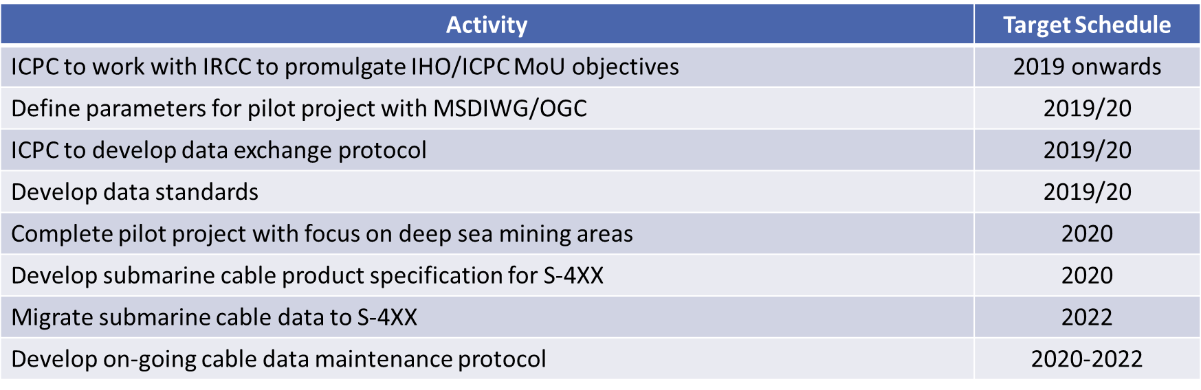
Future Work Plan

Slide 22
Actions requested of IRCC
As this is the first time participating at an IRCC meeting; IRCC is invited to note this ICPC update and report
IRCC is invited to note ICPC IHO/ICPC MoU objectives and to promulgate these objectives with Regional Hydrographic Offices and Regional Hydrographic Commissions
IRCC is invited to note the growing threat to submarine cable infrastructure from uncoordinated deep seabed mining activity and the need to chart cables to full ocean depth in these areas, recognising the need for ICPC members to provide as-laid cable data in a timely manner
As requested of HSSC; IRCC is invited to consider including seabed mining licenced boudaries on nautical charts
IRCC is invited to note the ICPC Work Plan
IRCC is invited to note dialogue with OGC with respect to commisionaling an Interoperability Experiment and future Pilot project the objective of
which is to delevelop an S4XX submarine cable product specification

Slide 23

www.ispcp.com
Sharing the seabed in harmony

